Slide 1
설비진단 교육
실습 세팅 (Colab)

Slide 2
아래 링크를 클릭하시면 각 노트북을 Google Colab에서 바로 열어보실 수 있습니다
[Practice_Python 1] Basics.ipynb
https://colab.research.google.com/github/jongmoonha/Signal_Processing_Practice/blob/main/%5BPractice_Python%201%5D%20Basics.ipynb
[Practice_Python 2] Data Load and Plot.ipynb
https://colab.research.google.com/github/jongmoonha/Signal_Processing_Practice/blob/main/%5BPractice_Python%202%5D%20Data%20Load%20and%20Plot.ipynb
a_FFT.ipynb
https://colab.research.google.com/github/jongmoonha/Signal_Processing_Practice/blob/main/a_FFT.ipynb
b_Filtering.ipynb
https://colab.research.google.com/github/jongmoonha/Signal_Processing_Practice/blob/main/b_Filtering.ipynb
c_Time_frequency.ipynb
https://colab.research.google.com/github/jongmoonha/Signal_Processing_Practice/blob/main/c_Time_frequency.ipynb
d_Envelope.ipynb
https://colab.research.google.com/github/jongmoonha/Signal_Processing_Practice/blob/main/d_Envelope.ipynb
e_Feature_CWRU_DE_IR.ipynb
https://colab.research.google.com/github/jongmoonha/Signal_Processing_Practice/blob/main/e_Feature_CWRU_DE_IR.ipynb
f_Time_frequency_advanced.ipynb
https://colab.research.google.com/github/jongmoonha/Signal_Processing_Practice/blob/main/f_Time_frequency_advanced.ipynb
g_deconvolution.ipynb
https://colab.research.google.com/github/jongmoonha/Signal_Processing_Practice/blob/main/g_deconvolution.ipynb

Slide 3
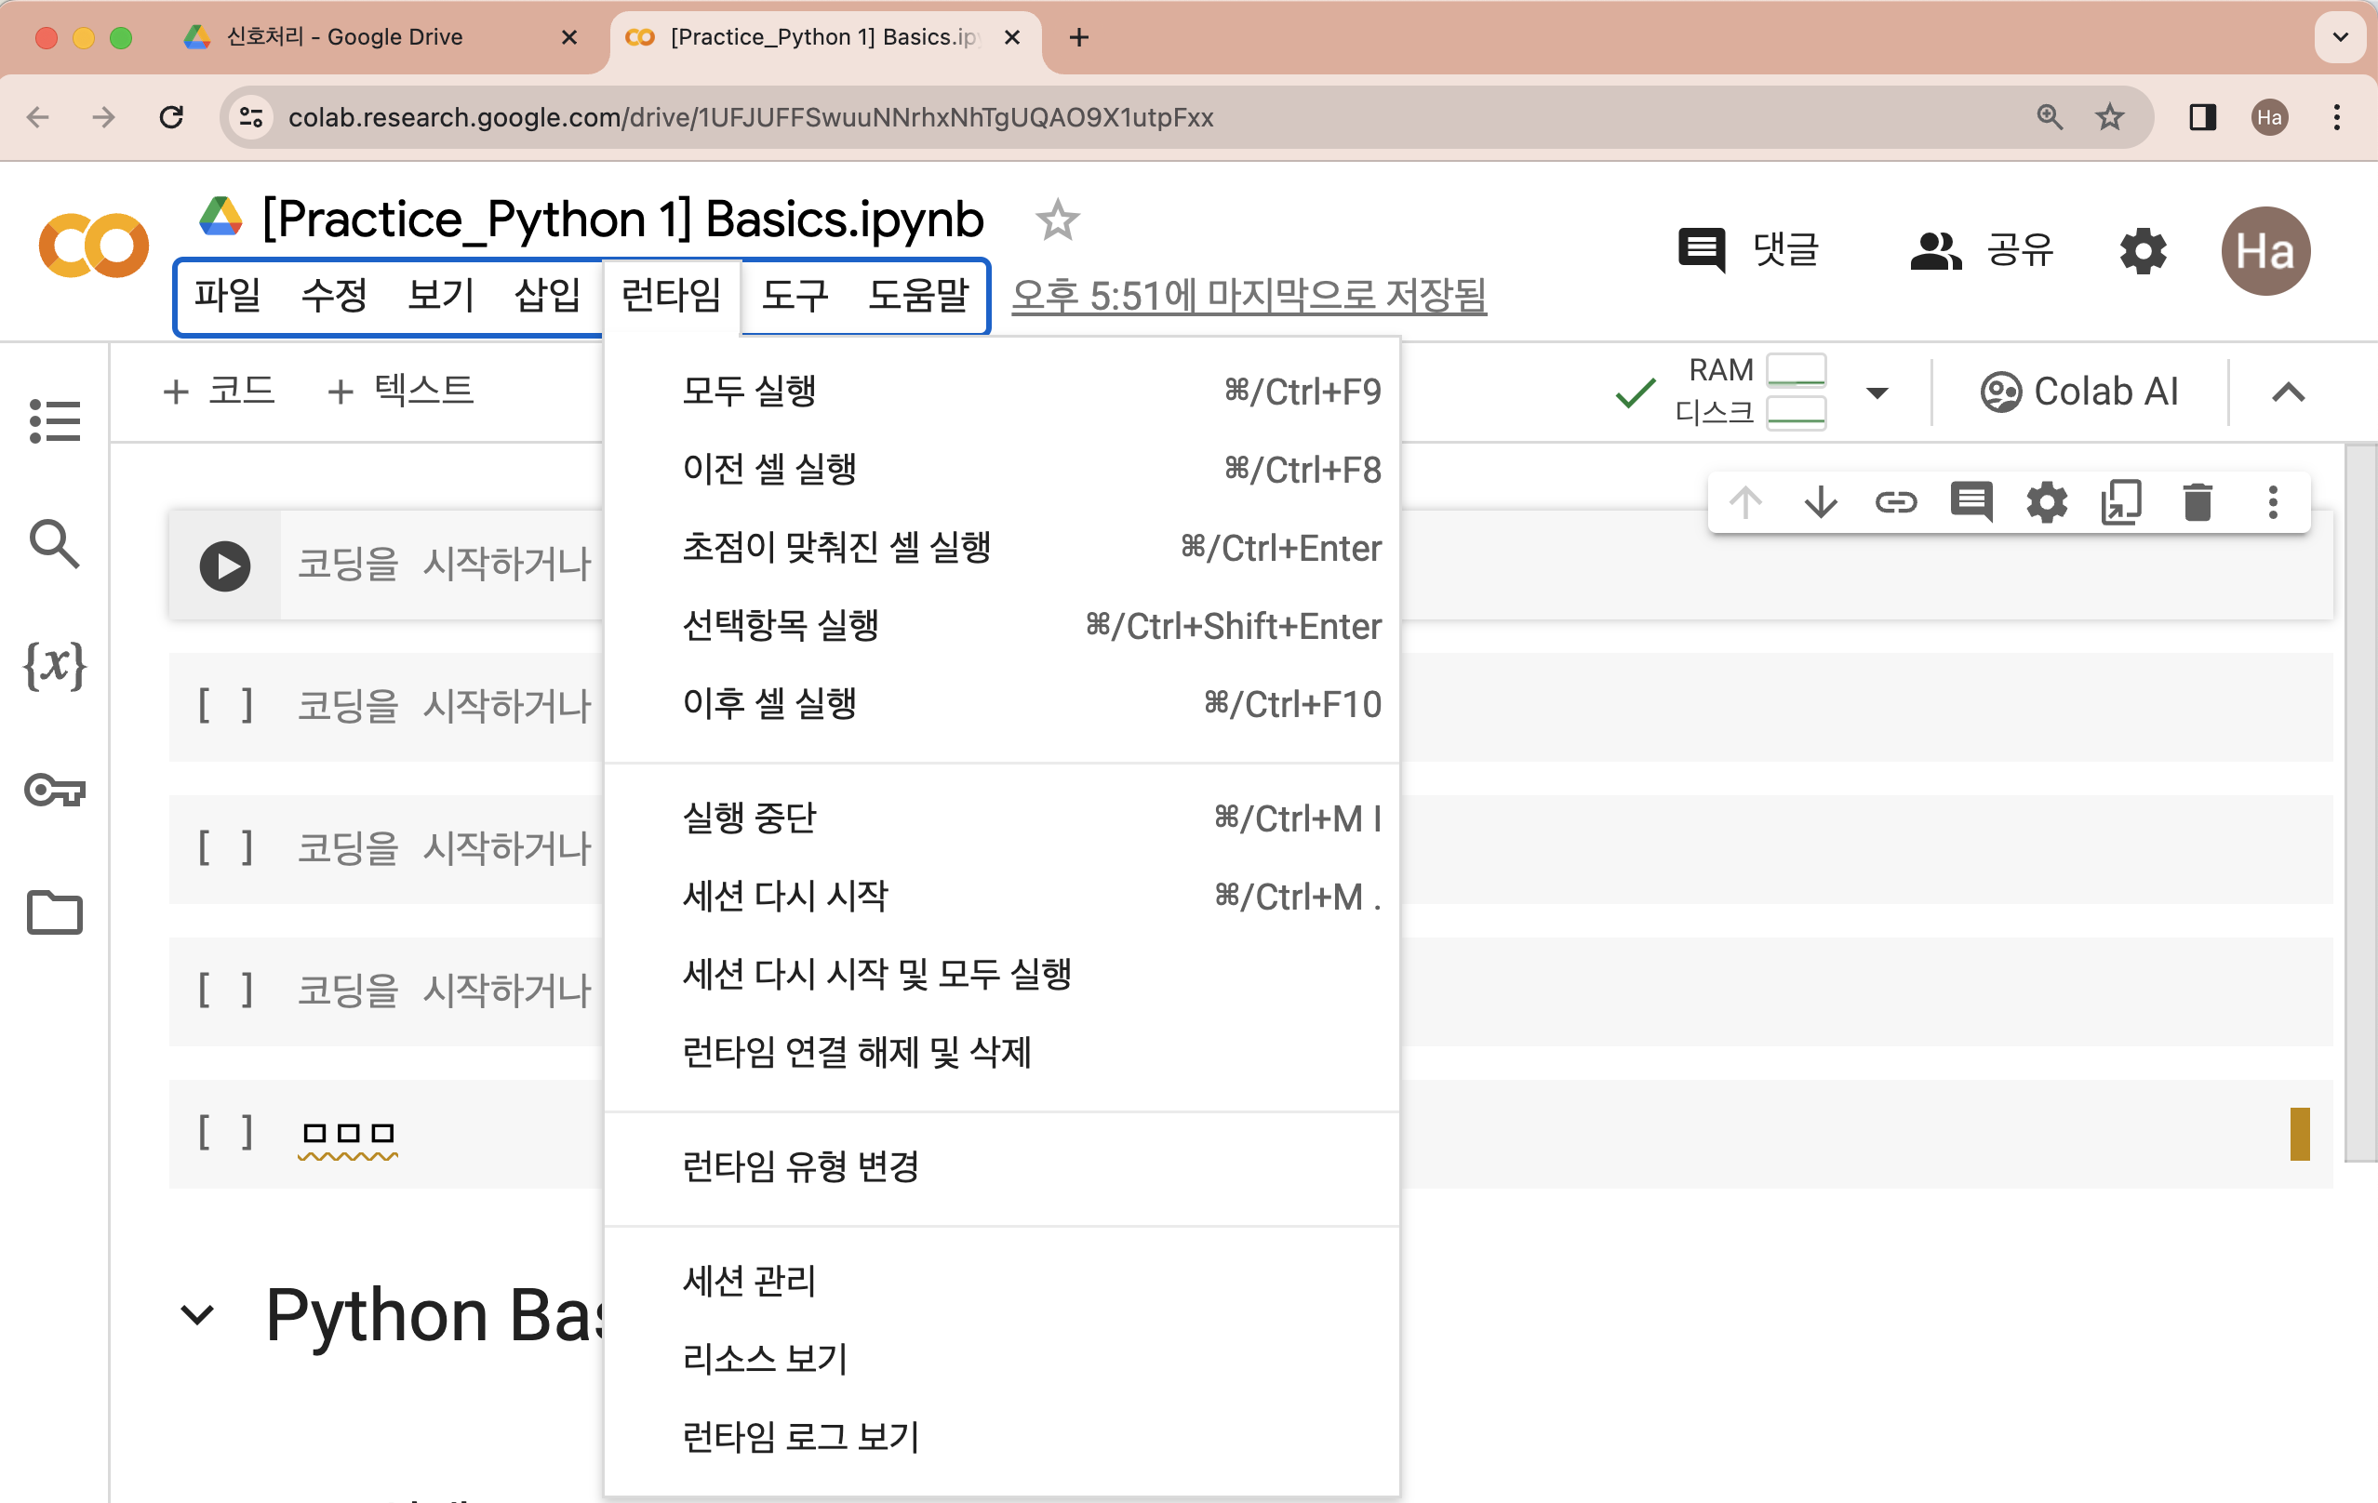
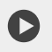
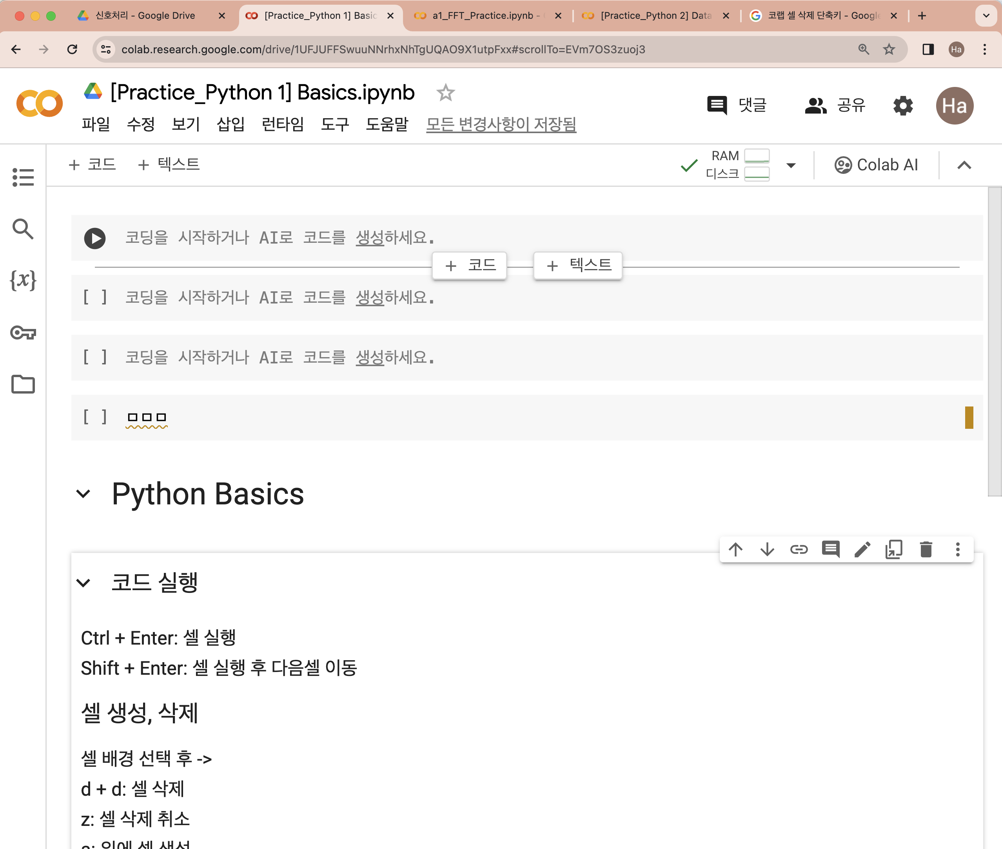
간단한 실행 방법
코드 실행
방법 1) 버튼 클릭
방법 2) Ctrl + Enter: 셀 실행
방법 3) Shift + Enter: 셀 실행 후 다음셀 이동
코드 전체 실행
상단 메뉴 ”런타임” → 모두 실행
셀 생성, 삭제
방법 1) 셀 하단, 상단에 마우스 위치한 후 버튼
방법 2)
[셀 배경 선택 후]
a: 위에 셀 생성
b: 아래에 셀 생성
d + d: 셀 삭제
z: 셀 삭제 취소

